Slide 1
Creating a Login form

Slide 2
The first step is we’re going to create a database for storing user’s information.
Open Microsoft Access and create blank database. Make sure you know where you save the file as this is important on OleDB Connection String later.
Create table and name it “tbl_user”. Depending on how you design the table, the 3 most important columns are ID, username and password.
Add these columns: “first_name”, “last_name”, “middle_name”, “age”, “address”, “user_level”, “username”, “password”

Slide 3
Nest step, open Visual Studio and create New Project for Visual Basic under Templates and select Windows Form Application. Name the application on whatever you want but I recommend letting the software do it.
After you create new project, Visual Studio will create a new form ready to use. We’re going to design this form and name it frmLogin.
Design the form same as below. Please take note of these important steps:
1.) Rename the username textbox to txtUsername and password textbox to txtPassword
2.) Rename the login button to btnLogin and cancel button to btnCancel

Slide 4
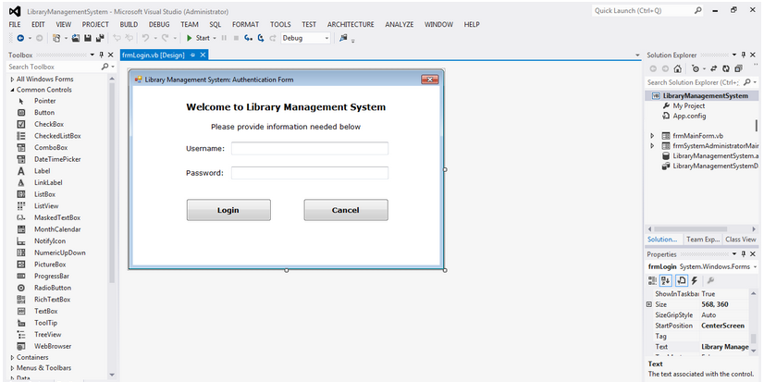

Slide 5
Double click on Login button. This will show you the coding window and your mouse focus is in inside btnLogin Click declaration as shown below.
Next step, we need to make sure that user provide both username and password so we are going to use If Else condition statement and OR comparison operator. Add this line inside btnLogin Private Sub.

Slide 6
If txtPassword.Text = "" Or txtUsername.Text = "" Then
MessageBox.Show("Please complete the required fields..", "Authentication Error", MessageBoxButtons.OK, MessageBoxIcon.Error)
Else
End If

Slide 7
We are using OR operator as it is must satisfy either one of the condition to be TRUE. So if the user enters either only username or password, error will be shown. The first statement is only a reminder of what this particular line of code is all about. Visual Basic compiler will not include this line when executing.
Notice that MessageBox.Show() has 4 arguments? It’s not required for those four completely but only for the first argument. The 1st argument is important as this will be shown to end user of whatever you have written on it. In this case, we’re going to use “Please complete the required fields..” to indicate the user that those fields are important. 2nd argument( “Authentication Error” )is the MessageBox caption at the left side of those Minimize, Maximize and Close button at the very top. 3rd argument is the button and last one is the icon( Red X ). See the figure below.

Slide 8
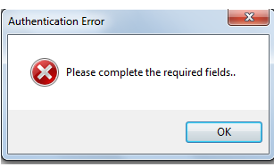

Slide 9
Next step we will do the connecting to database and execute data comparison inside Else condition. Add this line after the Else statement.
Connect to DB
Dim conn As New System.Data.OleDb.OleDbConnection()
conn.ConnectionString = "Provider=Microsoft.ACE.OLEDB.12.0;Data Source=|DataDirectory|\LibraryManagementSystem.accdb"

Slide 10
Next step we are going to use Try and Catch the Exception. Go back to your btnLogin Private Sub and add the code below.
Try
Catch ex As Exception
MessageBox.Show("Failed to connect to Database.. System Error Message: " & ex.Message, "Database Connection Error", MessageBoxButtons.OK, MessageBoxIcon.Error)
End Try

Slide 11
The MessageBox instances are the same as the previous one except we concatenate( ampersand & ) the exception message to let us know the exact error.
Add this code inside Try.
Dim sql As String = "SELECT * FROM tbl_user WHERE username='" & txtUsername.Text & "' AND password = '" & txtPassword.Text & "'"
Dim sqlCom As New System.Data.OleDb.OleDbCommand(sql)
'Open Database Connection
sqlCom.Connection = conn
conn.Open()
Dim sqlRead As System.Data.OleDb.OleDbDataReader = sqlCom.ExecuteReader()

Slide 12
The sql string holds the username and password comparison in SQL Statement format. Astrerisk( * ) means that we are going to fetch every column on tbl_user we’ve created earlier on matched record in WHERE condition output. In checking the required fields earlier, we use OR comparison operator in which only one conditions must be TRUE in order to satisfy. In here, we’re going to use AND as it will proceed only if both conditions are TRUE. Meaning username and password must be matched or it will fail. The sql will be executed and store in sqlRead variable.
Next step, were going to check if user enter correct username and password in order to proceed. Create another form and name it as frmMain. When user has been authenticated, this frmMain will show and we’re going to hide the frmLogin. Otherwise, we’re going to display error message, clear username and password text box and focus the set the input focus to username text field. Add the code below.

Slide 13
If sqlRead.Read() Then
frmMainForm.Show()
Me.Hide()
Else
' If user enter wrong username and password combination
' Throw an error message
MessageBox.Show("Username and Password do not match..", "Authentication Failure", MessageBoxButtons.OK, MessageBoxIcon.Exclamation)
'Clear all fields
txtPassword.Text = ""
txtUsername.Text = ""
'Focus on Username field
txtUsername.Focus()
End If

Slide 14
Our full code for btnLogin Private Sub will be like this:

Slide 15
Private Sub btnLogin_Click(sender As Object, e As EventArgs) Handles btnLogin.Click
' Check if username or password is empty
If txtPassword.Text = "" Or txtUsername.Text = "" Then
MessageBox.Show("Please complete the required fields..", "Authentication Error", MessageBoxButtons.OK, MessageBoxIcon.Error)
Else
' Both fields was supply
' Check if user exist in database
' Connect to DB
Dim conn As New System.Data.OleDb.OleDbConnection()
conn.ConnectionString = "Provider=Microsoft.ACE.OLEDB.12.0;Data Source=|DataDirectory|\LibraryManagementSystem.accdb"
Try
'conn.Open()
'MsgBox("Susscess")
Dim sql As String = "SELECT * FROM tbl_user WHERE username='" & txtUsername.Text & "' AND password = '" & txtPassword.Text & "'"
Dim sqlCom As New System.Data.OleDb.OleDbCommand(sql)
'Open Database Connection
sqlCom.Connection = conn
conn.Open()

Slide 16
Dim sqlRead As System.Data.OleDb.OleDbDataReader = sqlCom.ExecuteReader()
If sqlRead.Read() Then
frmMainForm.Show()
Me.Hide()
Else
' If user enter wrong username and password combination
' Throw an error message
MessageBox.Show("Username and Password do not match..", "Authentication Failure", MessageBoxButtons.OK, MessageBoxIcon.Exclamation)
'Clear all fields
txtPassword.Text = ""
txtUsername.Text = ""
'Focus on Username field
txtUsername.Focus()
End If
Catch ex As Exception
MessageBox.Show("Failed to connect to Database..", "Database Connection Error", MessageBoxButtons.OK, MessageBoxIcon.Error)
End Try
End If
End Sub

Slide 17
Next step we are going to code the btnCancel. It depends on how you want to do with the Cancel button. Mostly, other people simply exiting the program when clicking on Cancel button but in my case, I’m going to clear username and password field text and focus the key to username. So double click on Cancel button and add the code inside the btnCancel Private Sub. Note the below code is the complete Private Sub.

Slide 18
Private Sub btnCancel_Click(sender As Object, e As EventArgs) Handles btnCancel.Click
'User clicking on cancel button only clears field
' and refocus to first field
txtUsername.Text = ""
txtPassword.Text = ""
txtUsername.Focus()
End Sub

